Slide 1
Employee Data Analysis using Excel
STUDENT NAME: G.DIVYASHREE
REGISTER NO:422200478
DEPARTMENT: III B.COM (ISM)
COLLEGE: VALLIAMMAL COLLEGE FOR WOMEN

Slide 2
PROJECT TITLE
Employee Performance Analysis using Excel

Slide 3


AGENDA
Problem Statement
Project Overview
End Users
Our Solution and Proposition
Dataset Description
Modelling Approach
Results and Discussion
Conclusion
3/21/2024 Annual Review

Slide 4

PROBLEM STATEMENT
Salary analysis refers to the process of examining
and evaluating an organization’s salary structure
and compensation practices. Salary analysis helps
organizations ensure that their compensation
practices are fair, competitive, and aligned with
both employee expectations and market
conditions

Slide 5

PROJECT OVERVIEW
Analyze the salary of the employee by
considering various factors of like Gender ,
Employee ID, Start date , Employee type ,
Department ,etc.. We use these in order to
identify the trends , patterns of different
categories of employee Salary like very high
, high , medium and low

Slide 6

WHO ARE THE END USERS?

Slide 7

OUR SOLUTION AND ITS VALUE PROPOSITION
Conditional formatting : It is a excel feature that is used
to apply specific formatting to cells or range of cells in
certain criteria.
❖ Sort & filter : It helps to organize and analyze data
more effectively.
❖ Pivot table : It is used to summarize and analyze the
data.
❖ Chart : It is used to represent the data in visualization

Slide 8
Dataset Description
Employee dataset :
It is obtained from the edunet dashboard.
It has 11 features.
I have taken 5 features
Employee id: Numerical value
Name: Text type
Gender: Text type
Salary: Numerical values
Start date: Numerical value.

Slide 9

THE "WOW" IN OUR SOLUTION
We used the formula for salary analysis is:
=IFS(Z8>=5,”VERYHIGH”,Z8>=,”HIGH”,Z8>=3 ,”MED”,
TRUE,”LOW”
3/21/2024 Annual Review
9

Slide 10
MODELLING
DATA COLLECTION :
✦ Naan mudhalvan .
Edunet Dashboard.
FEATURE SELECTION :
11 Features.
5 Features.
DATA CLEANING :
Color blank values
Filter – Remove Blank Values
10

Slide 11
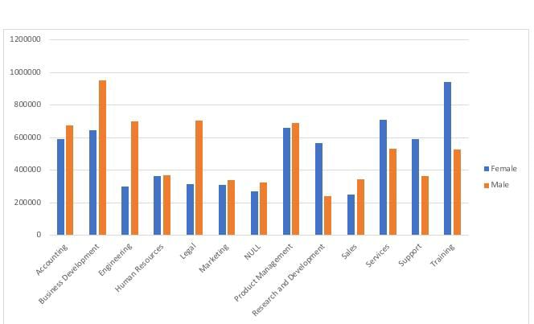
RESULTS
11

Slide 12


conclusion
In this project, I learned who to sort & filter
the data, conditional formatting, pivot
tables and how to insert charts.

